Slide 1

Людмила Владимировна Ещеркина
Времена глагола в английском языке
Челябинск
2018

Slide 2
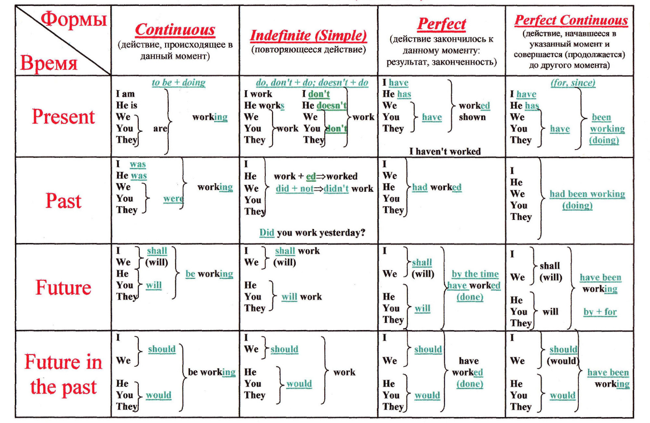
Времена в английском языке

Slide 3
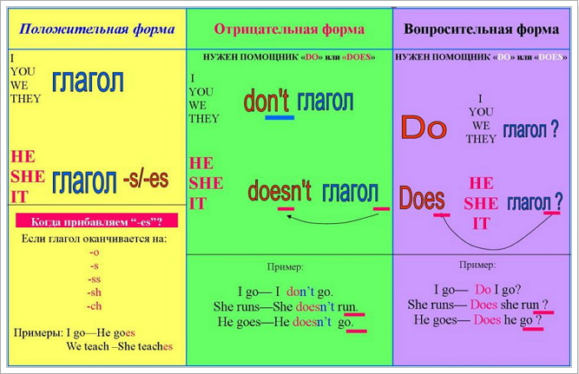
Present Simple

Slide 4
Present Simple | Маркеры
He goes to the office every day. - Он ходит в офис каждый день. | every day, every morning, every evening, usually, sometimes, often, seldom, always, never,

Slide 5
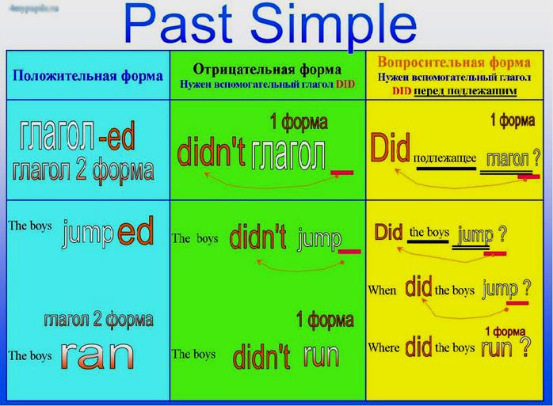

Slide 6
Past Simple | Маркеры
I learned new words yesterday– Вчера я учил новые слова. | yesterday, last year/month/week in 2000, 10 years ago,

Slide 7
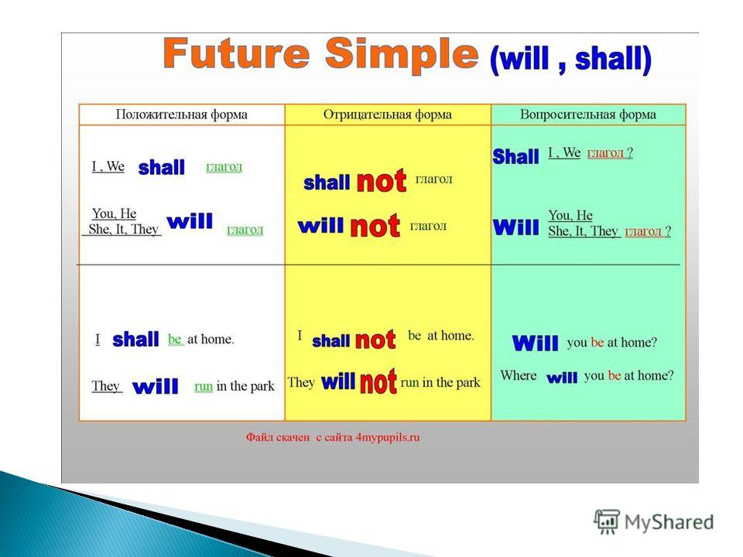

Slide 8
Future Simple | Маркеры
I will make a cake tomorrow morning. – Я испеку пирог завтра утром. | tomorrow, next week, next month, soon, some day

Slide 9
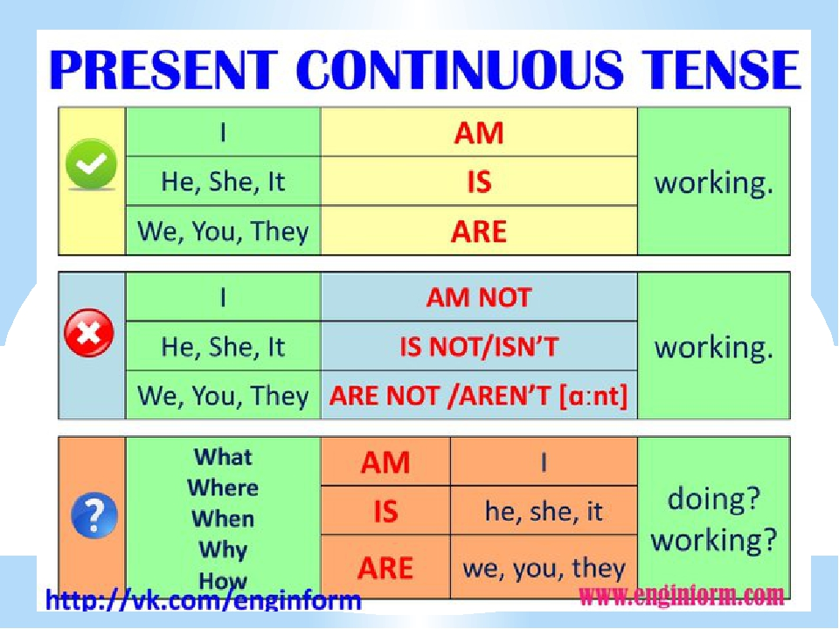

Slide 10
Present Continuous | Маркеры
I am reading now. – Я читаю сейчас. | now, at the moment, this week (month, year)

Slide 11
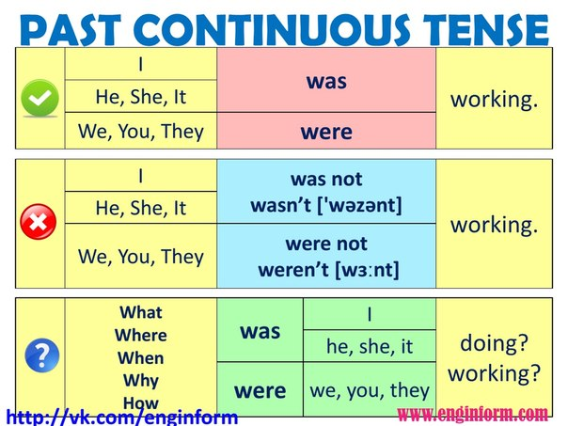

Slide 12
Past Continuous | Маркеры
He was watching TV at 6 o’clock yesterday. – Он смотрел телевизор вчера в 6 часов. | at 2 o’clock yesterday, when, while

Slide 13
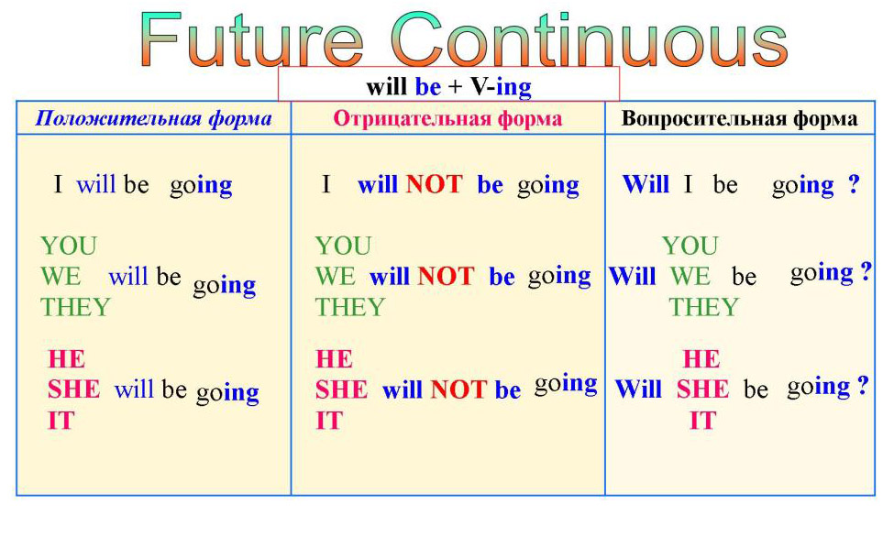

Slide 14
Future Continuous | Маркеры
This time tomorrow I will be attending Mrs. Brown’s lecture. - Завтра в это самое время я буду присутствовать на лекции миссис Браун. | when, while, this time tomorrow

Slide 15
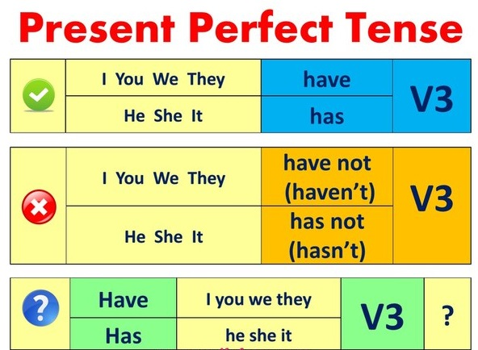

Slide 16
Present Perfect | Маркеры
He has already written a letter.- Он уже написал письмо. | many times, lately, recently, yet, already, ever, never, just, this time (week, year), for (for a long time, for ages), since (since morning,)

Slide 17
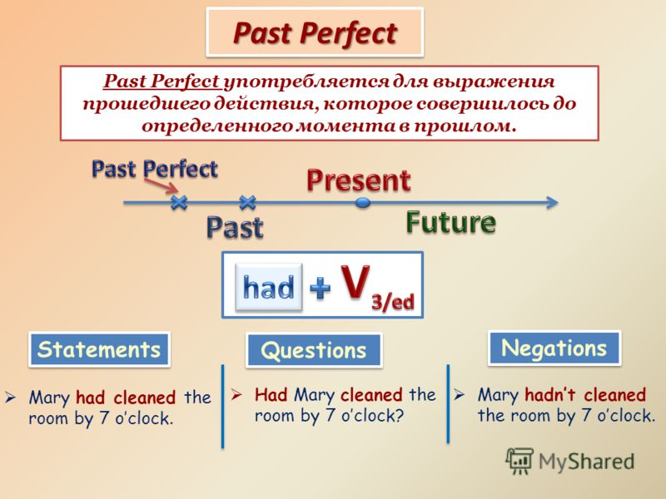

Slide 18
Past Perfect | Маркеры
He had translated the text by 5 p.m. – Он перевел текст к 5 часам вечера. | by, before

Slide 19
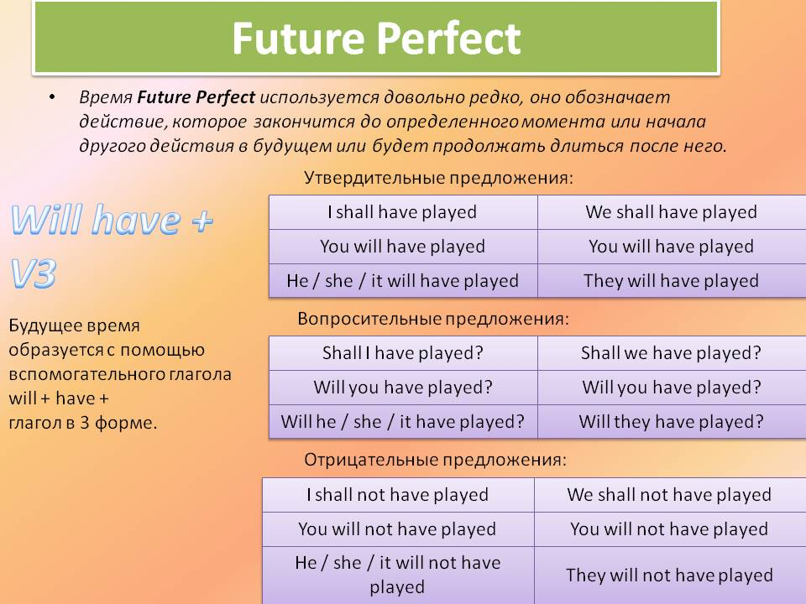

Slide 20
Future Perfect | Маркеры
He will have translated the text by 5 p.m. – Он переведет текст к 5 часам вечера. | by, before

