Slide 1
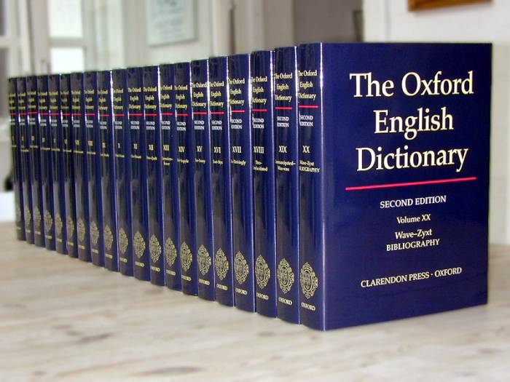
THE WORLD OF DICTIONARIES

Slide 2
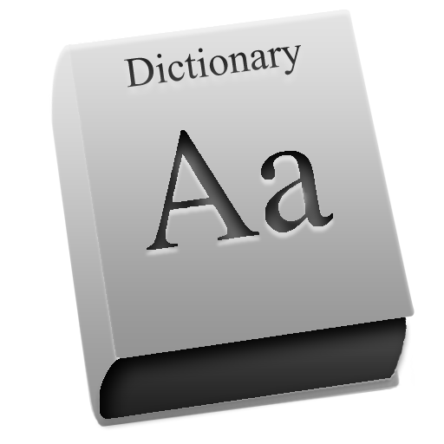
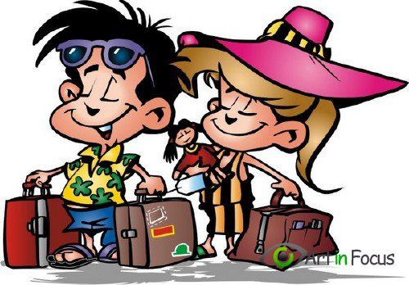
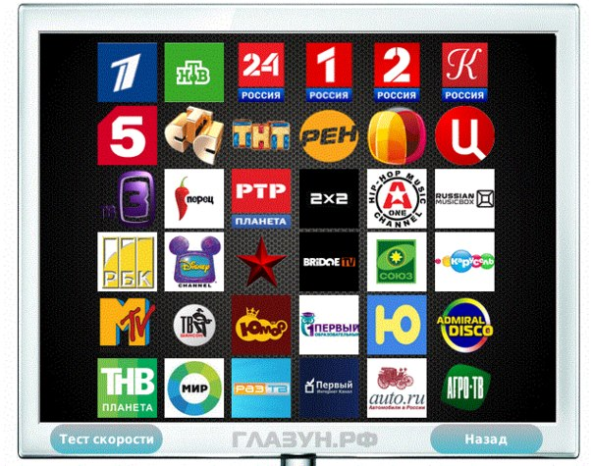
ENGLISH

Slide 3
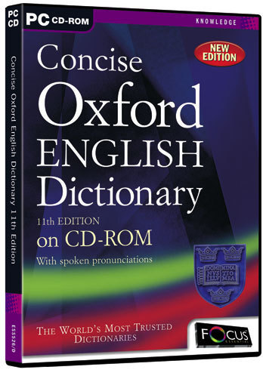
Dictionary
Monolingual
Bilingual
Alphabet
Pronounce
Entry
Meaning
Language
Vocabulary

Slide 4
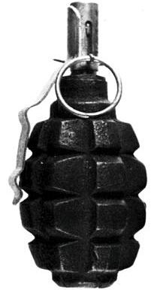
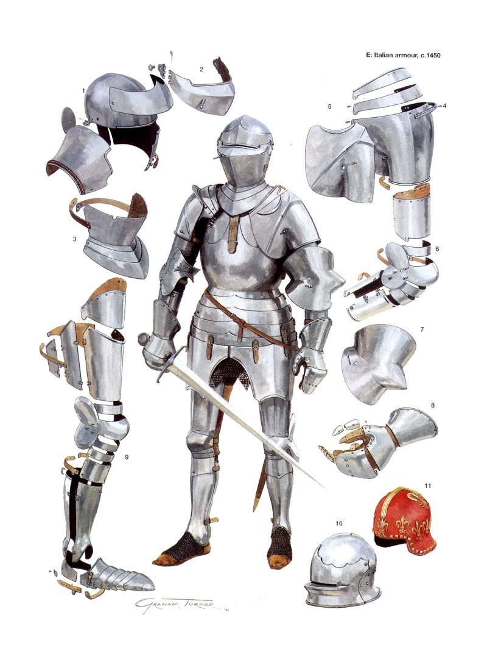
Rifle
A long gun that you hold against your shoulder
Grenade
a small bomb that is thrown by a hand
Armor
Clothing made of metal, leather and other hard mnaterials

Slide 5
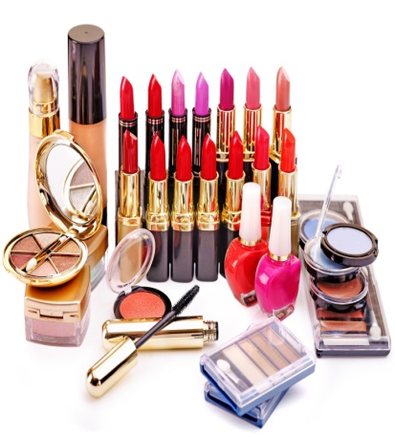
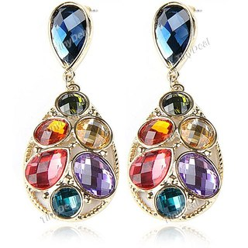
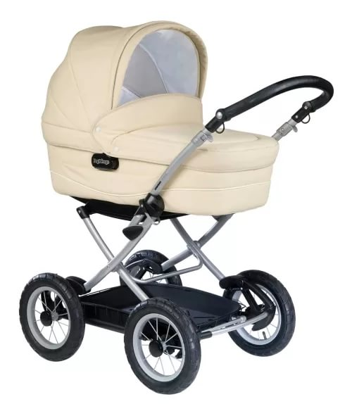
Make up
coloured substances used on your face to improve or change your appearance
Ear rings
a piece of jewellery that is worn on the ear and especially on the earlobe
Baby buggy
a small four-wheeled carriage often with a folding top for pushing a baby around in

Slide 6
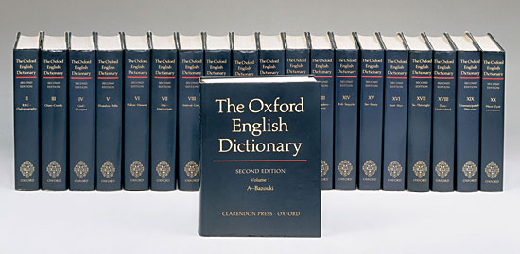
Answer the questions
Are dictionaries very useful?
What are the most popular kinds of dictionaries?
What is the first meaning of the word?

Slide 7
Don’t mix up!
dictionary
vocabulary

Slide 8
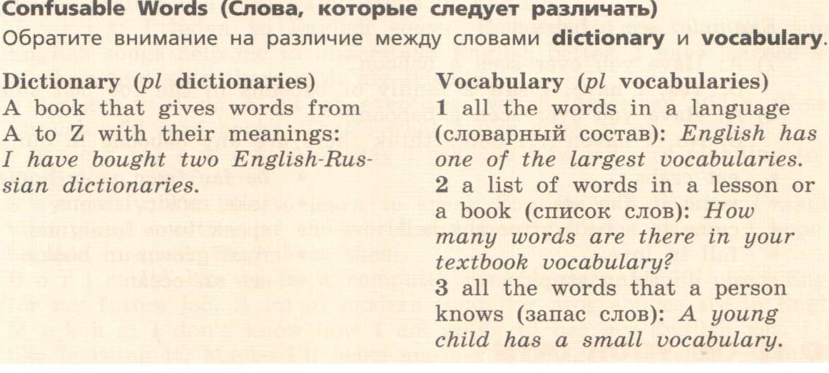

Slide 10
Learning Vocabulary
When you read something in English, don’t stop to look up every new word in the dictionary. Try to guess the meaning of a new word before you look it up in a dictionary.
Remember that words are given in alphabetical order.
Use both monolingual and bilingual dictionaries.
Try to put words into topic groups when you write them down. For example, words connected with travel, entertainment, work, etc.
Use a new word as soon as you can. This is always the final step in learning vocabulary.

Slide 11
Today I’ve learnt…
New words, and new expressions
Interesting facts about dictionaries and English
About the difference between mono and bilingual dictionaries
How to use modern dictionaries

Slide 12
How did you work during the lesson? It was easy ( difficult ) for me to…
speak on the topic
learn some new words
read the text
do exercises on grammar and vocabulary
do phonetic exercises

Slide 13
- find definition of 3 verbs, nouns, adjectives;
- prepare a presentation.

