Slide 1
Презентация к занятию по теме
«Carl Faberge
is the main Russian jewelry brand»
Подготовила :преподаватель
иностранного языка
ГБПОУ ПК им Овчинникова
Кутенцина Т.Г.

Slide 2
Actions speak louder than words

Slide 3
Carl Faberge is the main Russian jewelry brand

Slide 4
[ŋ]
[sil]
[ei]
jewelry
[ʤ]
[ǝƱ]
[f]
[w ]
[m]

Slide 5
ring
silver
chain
jewelry
gem
gold
sapphire
watch
semiprecious stone

Slide 6
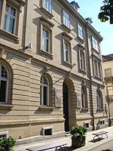
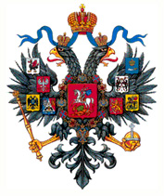
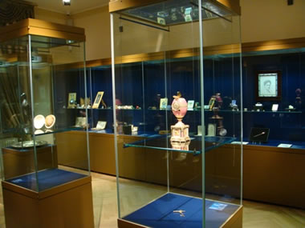
Faberge Museum in Baden-Baden

Slide 7
Carl Gustavovich Faberge

Slide 8
Gustav Fabergé and his wife Charlotte Jungstedt

Slide 9
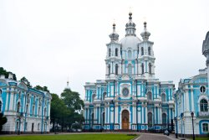
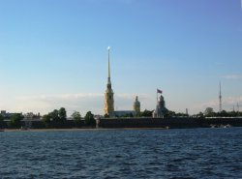
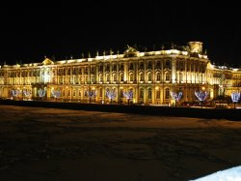

Slide 10
Gustav Farberge

Slide 11
Agathon Gustavovich Fabergé

Slide 13
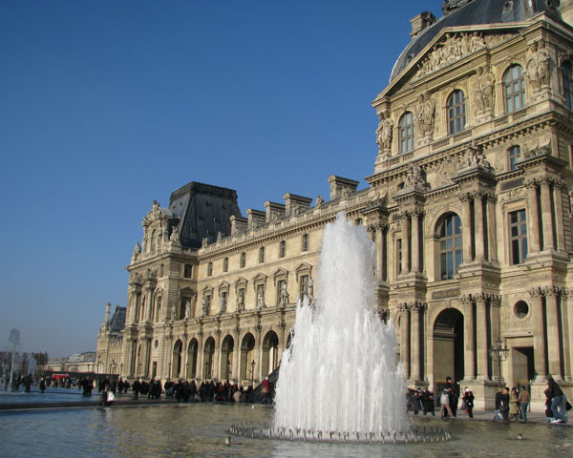
LOUVRE

Slide 14
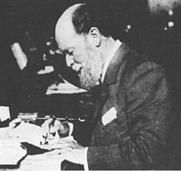
Peter Carl Faberge at work
Augusta Julia Jacobs (Faberge)

Slide 15
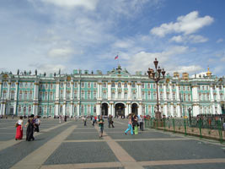
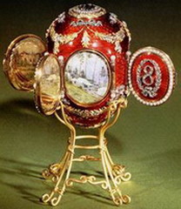

Slide 17
Faberge’s family

Slide 18
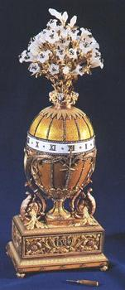
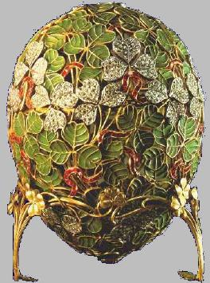
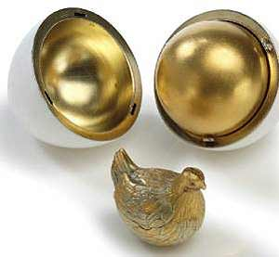
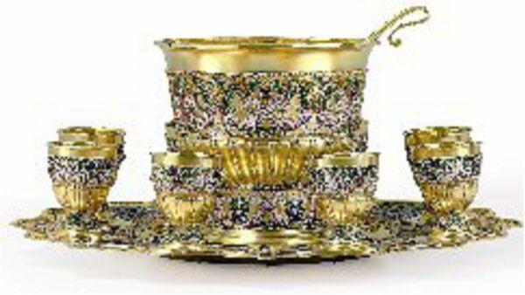
CREATIONS

Slide 19
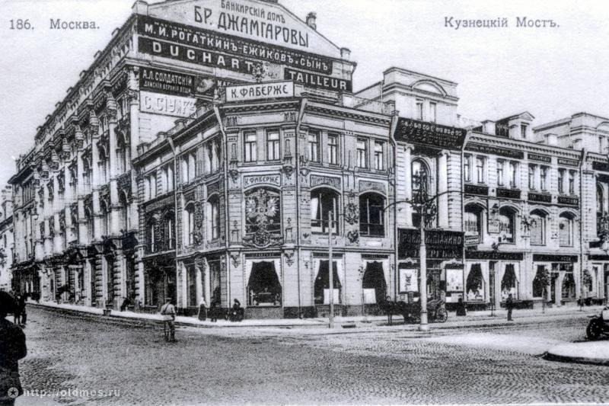
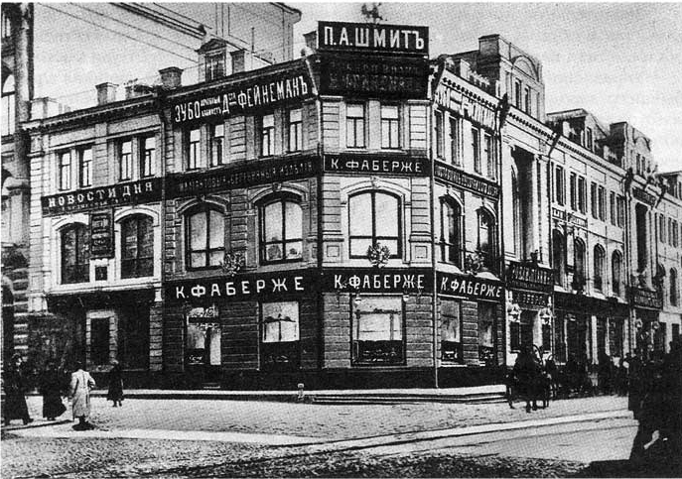

Slide 20
the House of Fabergé

Slide 21
Choose True or False.
1 | 2 | 3
4 | 5 | 6

Slide 22
The right answers.
1 True | 2 True | 3 True
4 False | 5 True | 6 False

Slide 23
MARKS
6 ANSWERS – 5
5-4 ANSWERS – 4
3 ANSWERS – 3
2 ˂ ANSWERS - 2

Slide 24
PUT THE RIGHT WORDS
1.)
2.)
3.)
4.)
5.)
6.)
7.)
8.)

Slide 25
ANSWER THE QUESTIONS
1. When did the House of Fabergé become a joint-stock company?
2. How much was the capital of the company?
3. Was the House of Fabergé nationalized by the Bolsheviks?
4. What did happen with the company in October?
5. After nationalization of the company Carl left for Riga, didn’t he?
6. Did Faberge die in Switzerland or in France?

Slide 26
 | Test | Words | Questions | Presentations
1. Golovachev N.
2. Drozhzhina N.
3. Razumtzev V.
4. Bilyalov R.
5. Zhukov S.
6. Petrova S.
7. Volkova A.
8. Polischuk N
9. Borodina N.
10. Nikulin A.
11. Razannik A.
12. Zaitsev A.
13. Zhuravlev A.
14.Zorkina K.
15. Guseinova A.

Slide 27
Thank you for the lesson.

Slide 28
СHECK YOUR ANSWERS
1.) company
2.) rubles
3.) October Revolution
4.) nationalized
5.) nationalization
6.) train
7.) heart
8.) sons

